Slide 1
The Cool Cat Coders Presents:
“Coming to a theatre near you”
A closer look at the top 10 movies from 1975-2018.

Slide 2
Overview:
Research the worldwide earnings of the top 10 movies from 1975-2018.
Research Question:
Can we find any trends between genre, production and earnings amongst top 10 highest earning movies worldwide from 1975-2018 ?
Sample Data Explored:
Box earnings throughout the years by genre
Production companies with highest gross sales by year
Sources: OMDb API & Kaggle CSV file

Slide 3

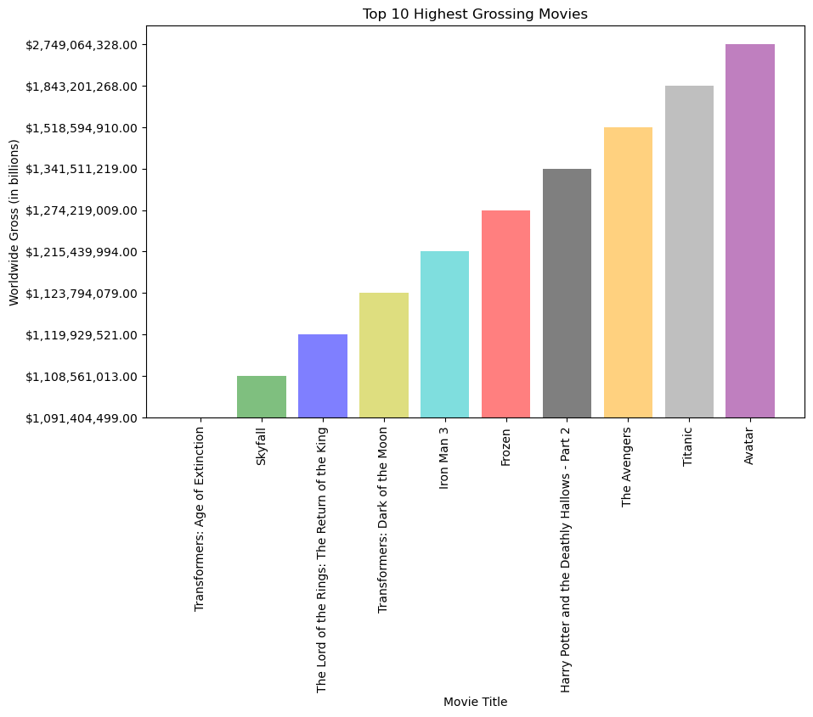
Highest Grossing Movies Worldwide
(Top 10 only from 1975 to 2018)
Avatar far exceeded as #1 top worldwide earner with close to $1B over the #2 top worldwide earner. Minimal difference in gross earnings between #2-#10 movies!

Slide 4
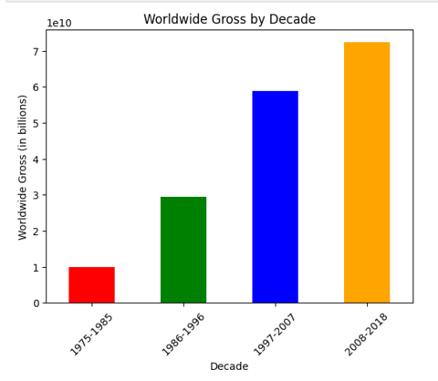
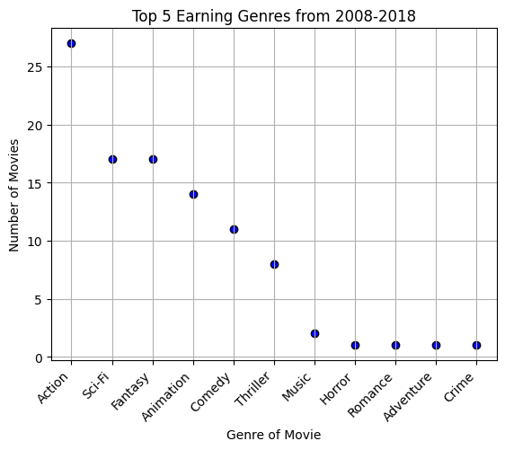
Difference in Worldwide Earnings Throughout the Years
Earnings worldwide increase as the decades go on with the highest earning decade being 2008-2018.
Top genre by far in ‘08-’18 decade was ‘Action’ with 27 movies, which was 90% of the total ‘Action’ movies in dataset.

Slide 5
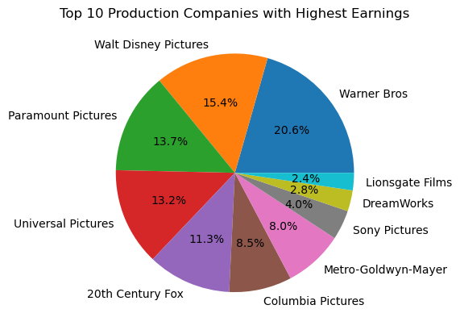
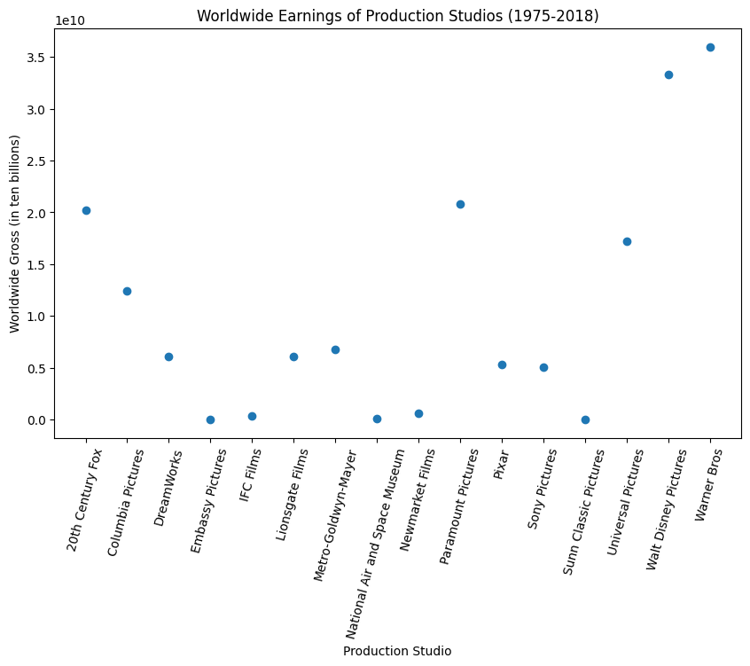
Key Production Company Information from Dataset
Over 70% of the worldwide earnings came from top 5 companies (WD, Warner, Paramount & Universal, 20th )..

Slide 6
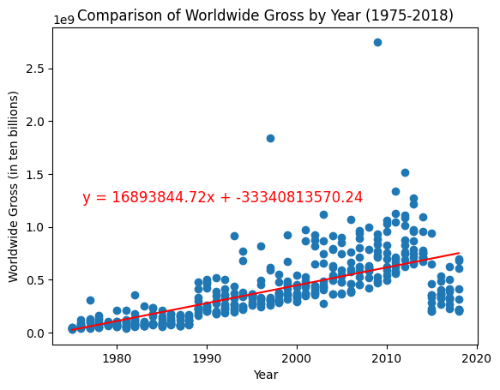
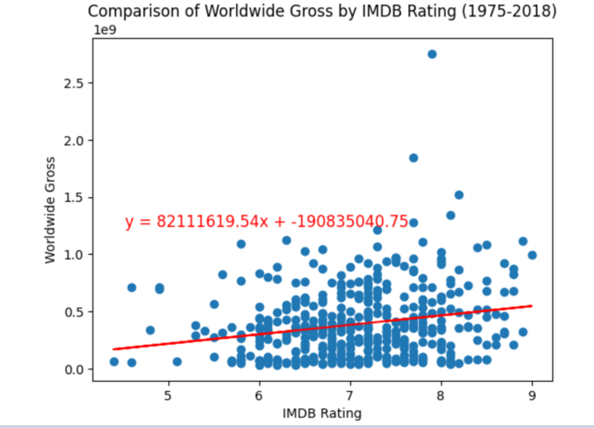
Statistical Testing - 2 Samples
The linear regression trend line shows that the earnings have consistently risen as the years have passed, hence showing that the movie business is a good business to invest in.
Expectation: Very strong positive correlation.
Reality: A correlation coefficient of 0.21 between IMDB rating and worldwide gross suggests a weak positive correlation between the two variables. This means that as the IMDB rating of a movie increases, the worldwide gross tends to increase as well, but the relationship is not very strong.
Notes:
P value has to come back with some significance in order to reject the null hypothesis. Null hypothesis : it is by random and not because there is a correlation. P < 0.05 in order for there to be a significance in the data… (meaning p value rejects the null hypothesis).
T tests - tells you how significant the differences between groups are.
T tests are used to see if averages can be used for representatives of the entire group. T tests is when you are working with 2 averages.
Anova test
Chi square 0 distribution of frequencies in the dataset meaningful

Slide 7
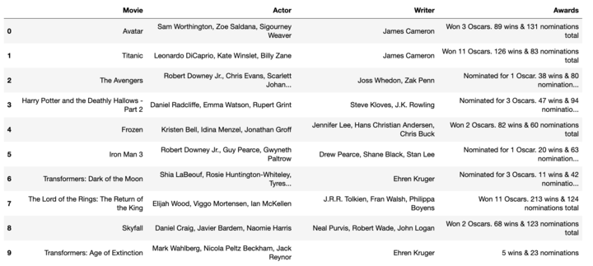

Additional Data Source: API (OMDb)

Slide 8
Lessons Learned;
Limitations between CSV file and API files can differ greatly - need to always look at what data provides first and the limitations before doing deep dives.
Helps tremendously to write out what you are attempting to do with your code for others to follow along on the team.
We have a love/hate relationship with Github. Github is sensitive. Very sensitive.

Slide 9

Veronica
Saroja
Taniya
Matty
**honorable mention to Taylor & Asim
The Cool Cat Coders

Slide 10
YOU CAN EMBED VIDEOS FROM YOUTUBE HERE OR EVEN VIDEOS PREVIOUSLY UPLOADED TO YOUR DRIVE

Slide 11
30th
CENTURY
WOLF
PRESENTS

Slide 12
OR HERE, SO THE CURTAIN DOES NOT GET IN THE WAY ;)

Slide 13
OR TAKE THE SITS AWAY.

Slide 14
HERE YOU CAN ADD AN INTRODUCTION FOR YOUR NEXT VIDEO

Slide 15
The Cool Cat Coders Presents:
“Coming to a theatre near you”
A look at the top 10 movies from 1975-2018.

